Slide 1
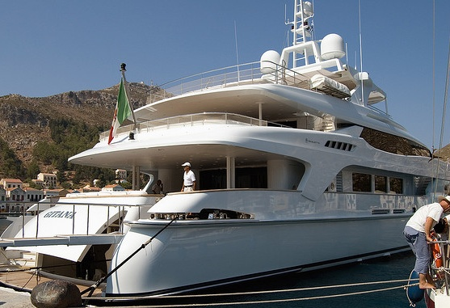
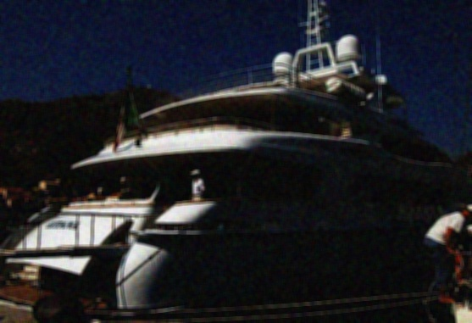
Synthetic low light image algorithm
Low light transformation
Noise
Blur

